Slide 1




MODEL DEVELOPMENT For NHANES DATASET
By Shimon Nauenberg

Slide 2

INTRODUCTION

Slide 3
BACKGROUND ON NATIONAL HEALTH AND NUTRITION EXAMINATION SURVEY(NHANES )
American survey ran by the National Center for Health Statistics
Began in the early 1960’s, and has been continuous since 1999
To assess the health and wellness of adults and Children in USA.
Includes both survey-based responses and medical and physiological measurement.
Used by many researches to track important aspects of health in the United states, such as Diabetes, Asthma, amongst many other things.

Slide 4
Our Objectives and Goal
We are interested in developing a model to predict Blood pressure (BPSysAve)
Particularly interested in the effect of smoking on Blood Pressure
We will be taking a subset of only 15 variables, and a sample of about 750 observations from the 2011/2012 survey year
We will use variable selection methods, shrinkage methods, and removal of outliers, and cross validation to try and find the best model

Slide 5

METHODS

Slide 6
Process
We will create 3 main models
We will use the lasso method for variable selection and stepwise selection using AIC and then BIC to determine an ideal model
We will then consider the VIF, outliers and bad leverage points to remove observations and variables.
We will then use the Box-Cox transformation to normalize the errors.
We will then use cross-validation and analyze the testing error to choose the best model

Slide 7

LASSO For Variable Selection

Slide 8
Var Selection
→After Running Variable selection we end up with Age as the only predictor
→This method Minimizes some coefficients to zero, and only non-zero coefficients remain

Slide 9
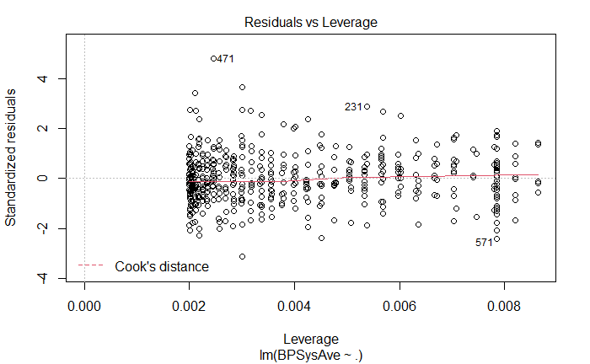
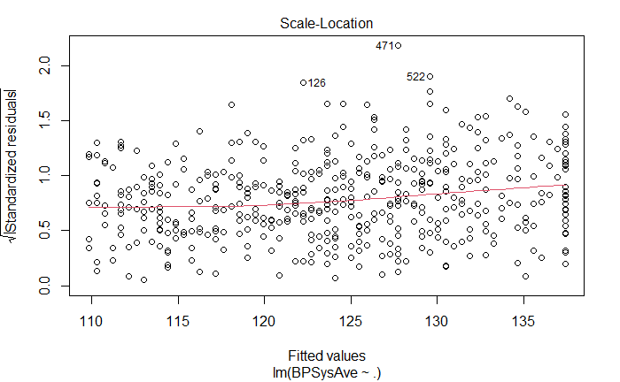
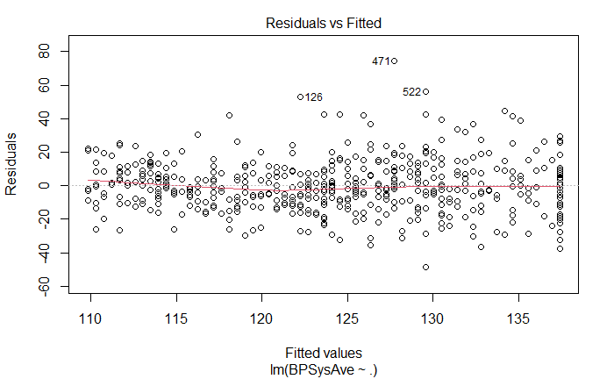
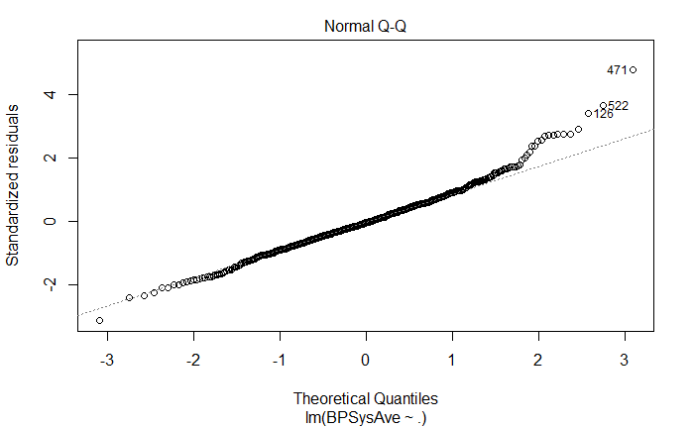
Diagnostic tests
We can notice that all the diagnostic visuals satisfy the assumptions, besides the QQ-Plot, which strays from the normal at the upper end.

Slide 10
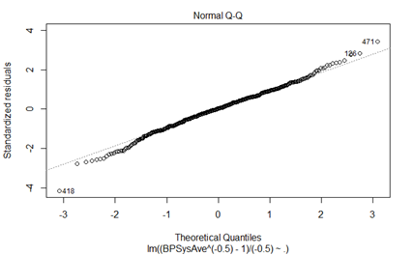
Outlier and BOX-COX
We Removed 4 influential points from this model.
we get BP: λ = -.5, AGE: λ = 1, from the Box-COX transformation
Following the Transformation THE QQ-Plot follows normality somewhat better.
We end up with an error of 0.0002.

Slide 11
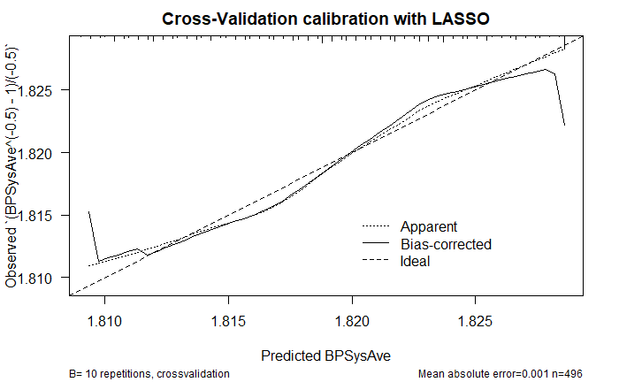
Validation and Test Error
We can notice that this model does not align with the ideal so nicely as it is quite a bit off the 1-1 line.
We end up with a error of 344.2352

Slide 12
AIC

Slide 13
Variable Selection
After running Step-wise Variable selection Focusing on AIC, we end up with 7 Predictors
Gender, Age, Race3, MaritalStatus, HHIncome, Poverty, SleepTrouble

Slide 14
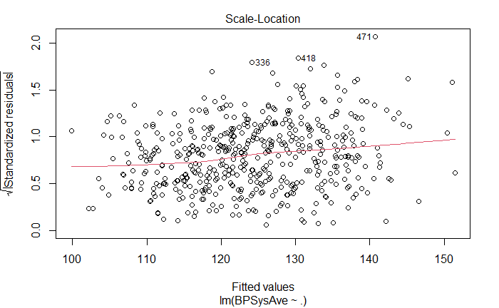
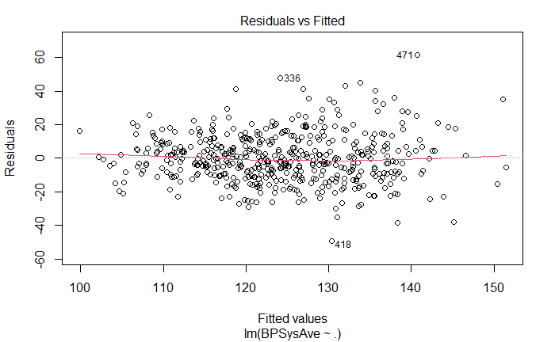
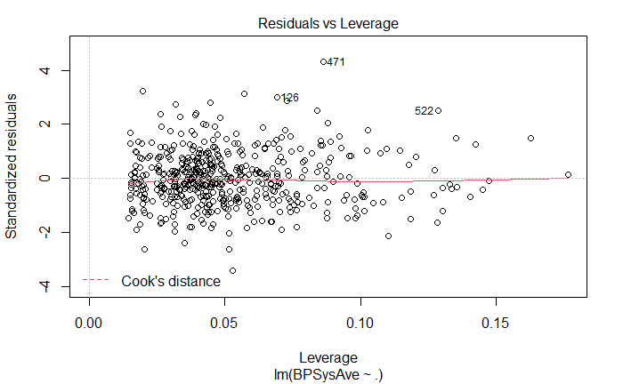
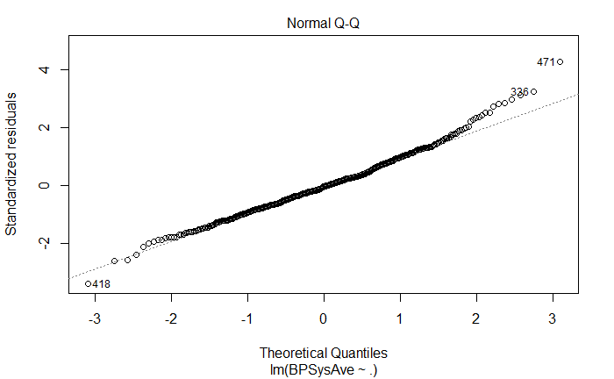
DIAGNOSTICS
We can notice that the QQ-plot does not follow normality Too well, while the other plots appear satisfactory as we would want them to satisfy the required assumptions
We Checked the correlation, and it was less then |.3| for all predictors left in the set of variables ( after removing for VIF).

Slide 15
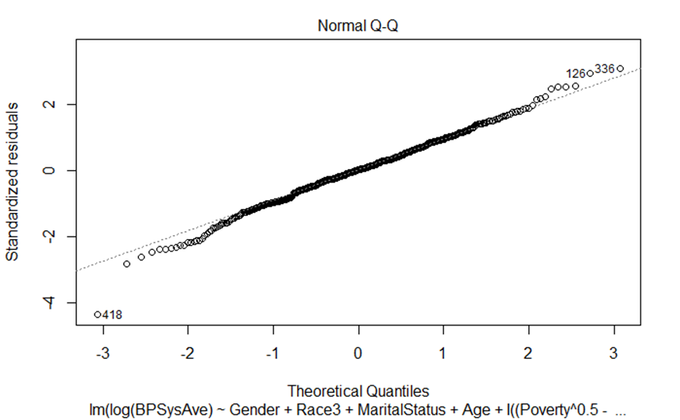
VIF, OUTLIERS, BOXCOX
We end up with a VIF of 6.38 for HHINCOME, and therefore remove it from our model
We also removed 33 observations.
These where observations which were either considered outliers by two or more methods or considered a leverage point and an outlier
We get BP: λ = 0, Age: λ = 1, POVERTY, λ = .5 using the BOX-COX method
We end up with a prediction error of 0.01231778
Following the transformation we can notice that the QQ-PLOT follows normality much better

Slide 16
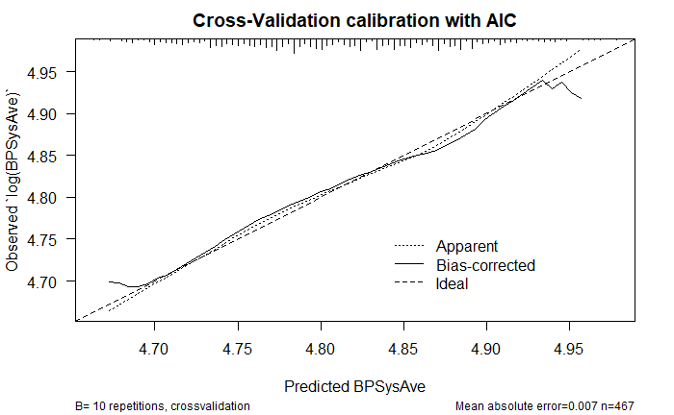
VALIDATION and TESTING
We end up with a testing error of 0.01540345
We can notice that the cross validation lies much closer to the ideal line, implying that this is a much better model than the lasso one.

Slide 17
BIC

Slide 18
Variable Selection
Following Step wise Variable selection focusing on BIC, we end up with predicters of Age and Poverty

Slide 19
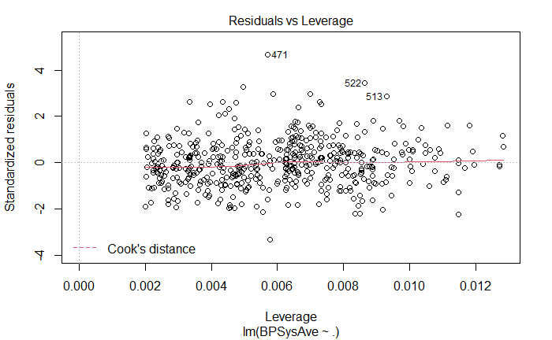
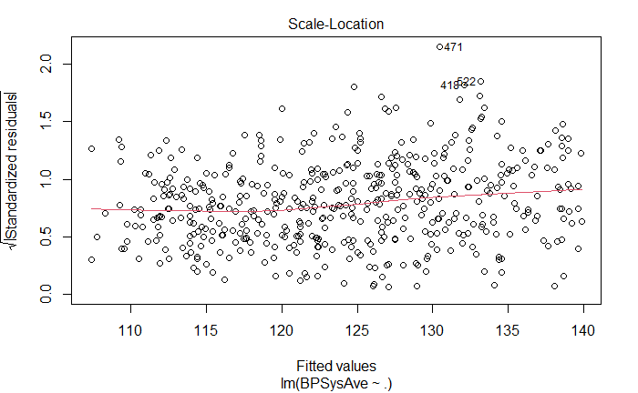
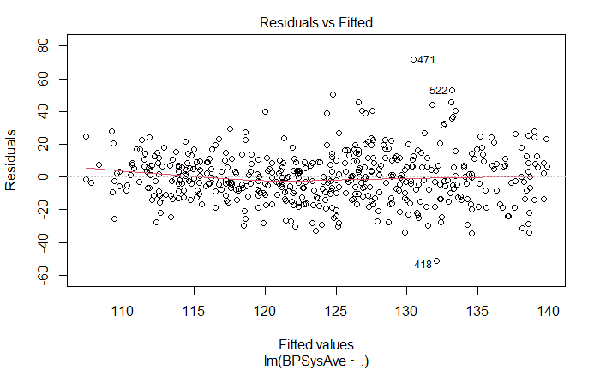
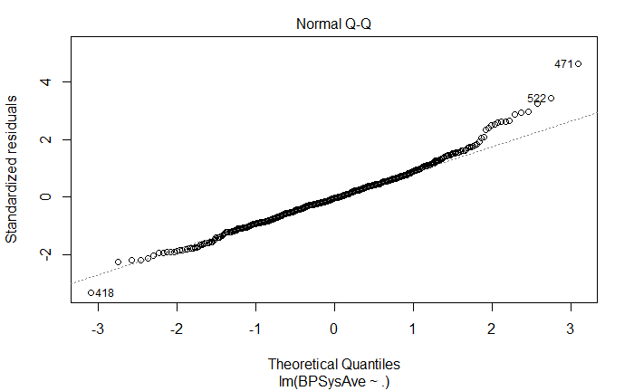
Diagnostic testing
We can notice that the plots besides the QQ-Plot are all behaving as we want them to for the purpose of assumption satisfaction
We checked the Correlation, and the predictors had a correlation less than |.1|

Slide 20
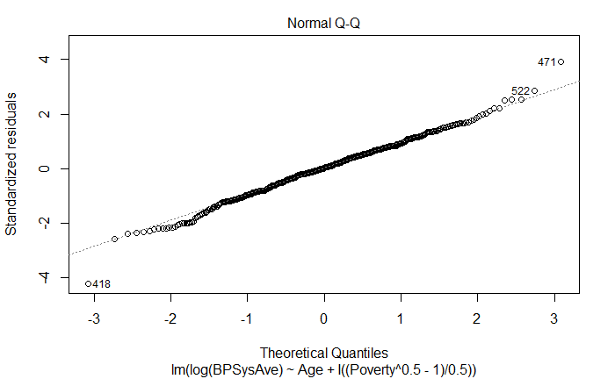
OUTLIERS, VIF, BOXCOX
We did not remove any predictors based on VIF, as none were above 5
We removed 14 observations, again only removing points which where considered outliers by two or more methods or were considered leverage points and outliers
We get BP: λ = 0, Age: λ = 1, POVERTY, λ = .5 using the BOX-COX method
We can notice that The QQ-Plot satisfies normality better than it did before
We had a prediction error of 0.01291148

Slide 21
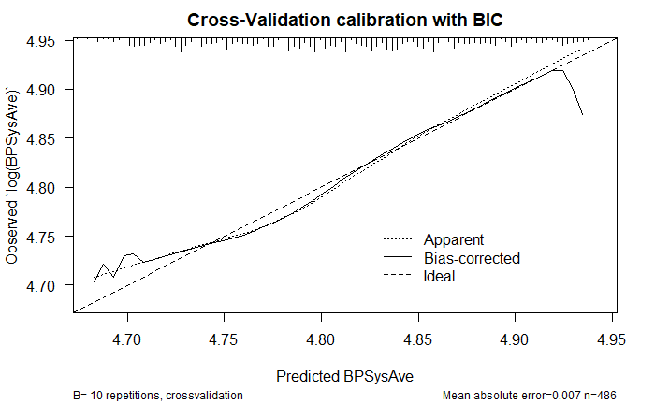
Testing and Cross Validation
We Notice that this model is much better at predicting that the LASSO model, but the curve does not align with the 1-1 line as well as the AIC model
We end up with a testing prediction error of 0.017

Slide 22
Best model
We choose the AIC model to be the best model.
This model had the lowest prediction error, and the lowest test prediction error.
This model also had the best calibration curve from the Cross validation

Slide 23
Adding in SmokeNow
We added the SmokeNow variable to the Transformed AIC model to look at our hypothesis of Smoking being a predictor of Blood Pressure

Slide 24
ANOVA Table
We can notice that by the p-value of the Smoke Variable we are unable to reject the null hypothesis that β_Smoke = 0.
Therefore, we would not reject the hypothesis that there is no relationship between Smoking and Blood pressure

Slide 25
Final Model and Interpretation
Our final model, the AIC model, has the following coefficients.
This can be interpreted as the following,
For all variables fixed besides age, for a one year increase in age there will be on average a 0.003 increase in log(Blood Pressure).
For Race3Other, given all other variables are fixed, there will be on average a 0.02 increase in log(Blood Pressure).

Slide 26
Conclusions and Limitations
Our best model is the AIC model
Further, we where unable to conclude that Smoking was a predictor for Blood Pressure.
We were able to get a model as desired, however the adjusted r squared was only 0.2477333, meaning only about 25% of the variation explained by only the independent variables affect BP
Therefore, although, our model is pretty good, it could be much better.
https://www.statisticshowto.com/probability-and-statistics/statistics-definitions/adjusted-r2/

